Slide 1
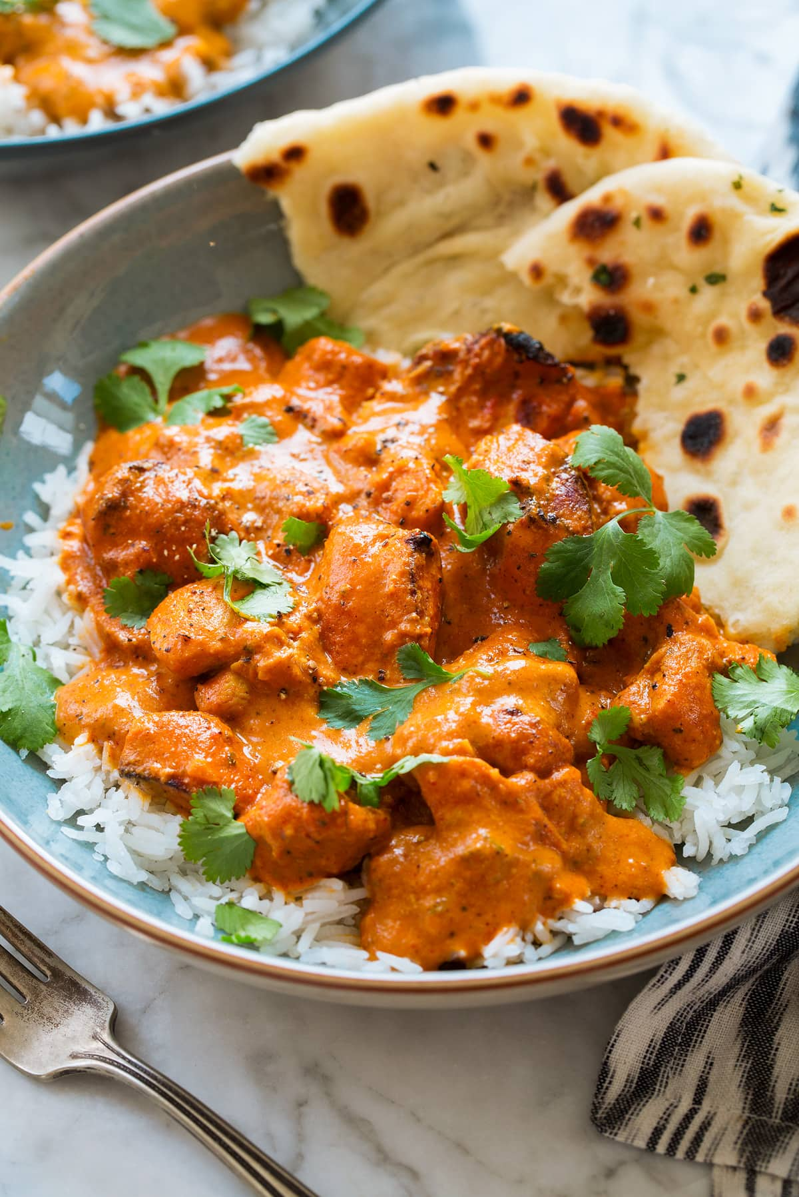
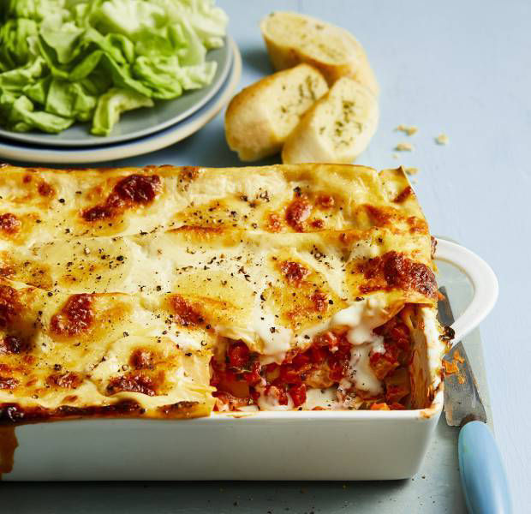
Family Cooking Workshop @NBA
Have fun!
Book cooking session now!
Ingredients provided!
Learn something new!
Details:
Available Spaces: 8 pairs (1 child + 1 adult- First come first served basis)
Dates: 15th June 2024
Menu: a choice of
Home made butter chicken curry with naan
Vegetarian Lasagne with garlic bread
Note: Bring a container to take your food home!
I am looking forward to you joining me in the kitchen room!
Miss S Dolan

