Slide 1
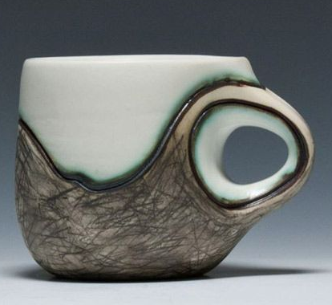
Family Ceramic Workshop @NBA
Have fun with clay!
Book 2 part workshop to hand build your own bird house or a mug!
Part1: Building Part2: Glazing
Learn something new!
Details:
Available Spaces: 15 pairs (1 child + 1 adult- First come first served basis)
Dates:
Part 1: 15th June 2024 (building your clay work)
Part 2: 6th July 2024 (glazing your pieces)
Note: Your finished artworks will be ready and available for collection from Thursday 11th July!)
I am looking forward to you joining me in the art room!
Mrs M Whitaker
Be creative!

