Slide 1
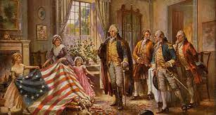
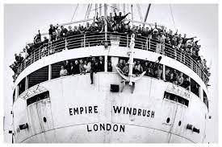
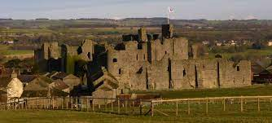
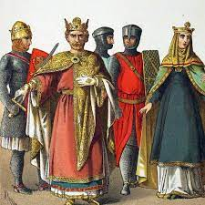
YEAR 7-11 History
PIN BANK
Simply drag a pin to add it to your journey
Destination One: Qualifications for College Apprenticeships or Work.
Kenilworth Castle review
The Nazis
People’s Health
Destination Two – Continue studying History at
A-Level.
People’s Health
Kenilworth Castle
YEAR 11
American History
Was the British Empire a force for good?
The Norman Conquest
Did the British Empire and the Windrush lead to a better Britain as promised?
Terrorist or freedom fighters?
YEAR 10
American history
Why did no-one stop it?
Why was the world at war again years after WW2?
The Nazis
Has BLM been a success?
Was it all buses and boycotts?
YEAR 9
Who writes our history?
Was George Nock’s war the same as everyone else's?
Why did the world nearly came to an end?
Why do we love jack the Ripper a murderer?
How did China go from a backwards farming society to a major global power?
How did Britain change as a result of The Industrial Revolution?
YEAR 8
Is it better now then when my grandad was born?
Was communist rule good for the people of Russia?
Was the slave trade a necessary evil for Britain?
YEAR 7
Why did so many people
Die by the age of 30 in Medieval Britain?
Did the Normans have a positive impact on Britain?
LEARNING JOURNEY

