Slide 1
YEAR 7-11 Spanish
Destination One: Qualifications for College Apprenticeships or Work.
Future plans
Careers & Jobs
Destination Two – Continue studying Spanish at
A-Level.
Household Chores
YEAR 11
Social Issues
Exam Skills
Gap Year
Work Experience
Part-time Jobs
Communication Skills
Free time
Technology
Social Media
Plans for GCSE
Environment
Relationships
YEAR 10
Town
Going out
Festivals
Physical descriptions
Mobile phones
Your studies
Holidays
Your school
School items
City or countryside?
Your city
Your local area
YEAR 9
Family life
Directions
Your dream house
School subjects
Weekend plans
Household chores
Sports
Free time
Types of houses
Hobbies
YEAR 8
Physical description
Personality
Weather
Your room
Your house
Pets and animals
Hispanic Flags
Spanish Numbers 1-30
The Hispanic World
Family members
YEAR 7
Forming Larger numbers 30-100
Colours
Spanish Greetings & Introductions
LEARNING JOURNEY

Slide 2
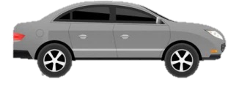
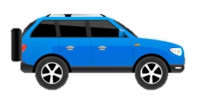
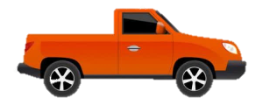
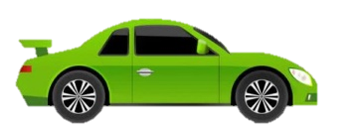
YEAR 10 Spanish
PIN BANK
The red box:
These road work boxes can be used to highlight a particular task, or link parts of the journey to the national curriculum.
Just copy and paste when needed and drag to map position, editing position of pin if necessary. Type over this text.
Simply drag a pin to add it to your journey
Year 11
Spanish
Booking doctors appointment
Reserving a table
Reserving a hotel
Assessment
Making an exchange
The red box:
These road work boxes can be used to highlight a particular task, or link parts of the journey to the national curriculum.
Just copy and paste when needed and drag to map position, editing position of pin if necessary. Type over this text.
Social Issues
Homelessness
Natural disasters
Assessment
END OF TERM
HALF TERM
Assessment
Improving our planet
Environmental Issues
Town improvements
HEADING
Assessment
Future environment
Our world
My ideal town
Spanish Festivals
Hispanic Festivals
Assessment
Daily routine
My town
Positives and negatives of my town
Assessment
Next years holiday
Last years holiday
My holiday
CAR PARK
Why not
START
Holiday problems
Weather
LEARNING JOURNEY

Slide 3
YEAR 9 Spanish
PIN BANK
The red box:
These road work boxes can be used to highlight a particular task, or link parts of the journey to the national curriculum.
Just copy and paste when needed and drag to map position, editing position of pin if necessary. Type over this text.
Simply drag a pin to add it to your journey
Year 10
Spanish
Healthy living
Lifestyle changes
Food & drink
Assessment
Bad habits
The red box:
These road work boxes can be used to highlight a particular task, or link parts of the journey to the national curriculum.
Just copy and paste when needed and drag to map position, editing position of pin if necessary. Type over this text.
Sports
Music
Assessment
END OF TERM
HALF TERM
Cinema
Childhood
Assessment
School rules
My teachers
My GCSE’s
HEADING
Assessment
School clubs
My school
Importance of languages
Social media
School studies
Mobile phones
Assessment
Technology
Online safety
The school day
Assessment
Going out
Family relationships
My family
CAR PARK
Why not
START
Free time
Physical description
LEARNING JOURNEY

Slide 4
YEAR 8 Spanish
PIN BANK
The red box:
These road work boxes can be used to highlight a particular task, or link parts of the journey to the national curriculum.
Just copy and paste when needed and drag to map position, editing position of pin if necessary. Type over this text.
Simply drag a pin to add it to your journey
Year 9 Spanish
Matadors
Bullfighting
Assessment
HALF TERM
Hispanic traditions
The red box:
These road work boxes can be used to highlight a particular task, or link parts of the journey to the national curriculum.
Just copy and paste when needed and drag to map position, editing position of pin if necessary. Type over this text.
Spanish traditions
School clubs
Assessment
END OF TERM
END OF TERM
HALF TERM
My school
School subjects
School items
HEADING
HALF TERM
The school day
School studies
END OF TERM
My city
Directions
Weekend plans
Assessment
My town
City or countryside
HALF TERM
My chores
My house
CAR PARK
Why not
Assessment
START
My ideal home
My room
LEARNING JOURNEY

Slide 5
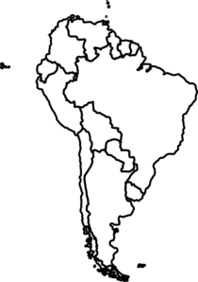
YEAR 7 Spanish
PIN BANK
The red box:
These road work boxes can be used to highlight a particular task, or link parts of the journey to the national curriculum.
Just copy and paste when needed and drag to map position, editing position of pin if necessary. Type over this text.
Simply drag a pin to add it to your journey
Year 8 Spanish
Guillermo del toro
Day of the dead
Assessment
The red box:
These road work boxes can be used to highlight a particular task, or link parts of the journey to the national curriculum.
Just copy and paste when needed and drag to map position, editing position of pin if necessary. Type over this text.
Mexican traditions
Weather
Music
Assessment
END OF TERM
END OF TERM
HALF TERM
HALF TERM
Sports
Hobbies
HEADING
END OF TERM
Assessment
Numbers 30-100
Pets & animals
Personality
HALF TERM
My family
Physical description
Assessment
Flags
Numbers 1-30
Hispanic countries
CAR PARK
Why not
START
Colours
Spanish greetings
LEARNING JOURNEY

