Slide 1
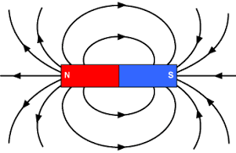
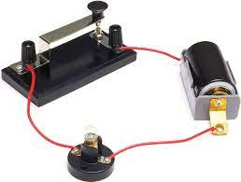
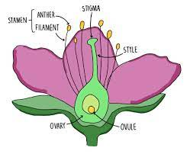
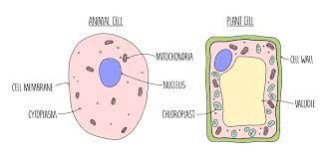
YEAR 7-11 Science
PIN BANK
Destination One: Qualifications for College Apprenticeships or Work.
Paper 2 Revision
Paper 1 Revision
Destination Two – Continue studying Biology, Chemistry and Physics at
A-Level.
GCSE exam
YEAR 11
Variation
Water
Electromagnetic spectrum
Ecosystems
Magnetic fields
Biology- Organisms and disease
Physics- Electricity in circuits and in the home
Chemistry- Electrolysis
Inheritance
Atmosphere
Waves
Physics-Energy transfer and conservation
Hormones
Hydrocarbons
Forces
YEAR 10
Chemistry- Chemical reactions
Biology- Non-communicable disease and energy
Nervous system
Collision theory
Speed
Chemistry- Atoms
and bonding
Chemistry- Earth history
Chemistry- Metals
and acids.
Chemistry-Extracting pure substances
Physics- Where does energy come from?
YEAR 9
Biology- Cell organisation
Biology- Organisms and adaptations
Physics- Motion and pressure
Biology-Energy transfer in an ecosystem.
Chemistry- chemical reactions
Chemistry- acid and alkalis
Biology- Staying healthy
Biology-Reproduction in plants and animals
YEAR 8
Physics- Light
Physics- Solar system
Chemistry- The Periodic table
Physics- Circuits
Physics- Sound
Biology- Organ systems
Chemistry- Matter
How do we work scientifically?
Chemistry- Elements and compounds
YEAR 7
Physics- Forces
Biology- cells
LEARNING JOURNEY

