Slide 1
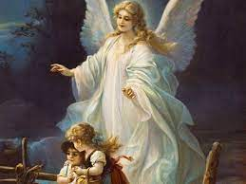
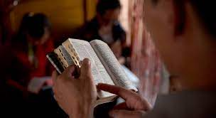
YEAR 10 RE GCSE
PIN BANK
Simply drag a pin to add it to your journey
Year 11
RE
Theme E: Crime & Punishment
Human rights
Ethics & Morals
Aims of Punishment
Role & status of women
Assessment
Assessment
Origins of Life
Theme F: Human Rights & Social Justice
Poverty
Race & Disability
Crime
Animal rights
Muslim Practices
Abortion
10 Obligatory acts
Festivals – Eid / Ashura
Theme B: Religion & Life
5 Pillars
Assessment
Assessment
Prophethood
Euthanaisa
Tawhid
Muslim Beliefs
6 articles of Faith
Al - Qadr
Angels
Holy Books
5 roots of Usul ad din
Assessment
Festivals
Importance of a Family
Divorce
Persecution
Assessment
Mission & Evangelism
Theme A: Relationships & Families
Marriage
Value of Families in the Local Parish
Role of the Church
Importance of Worship
START
Christian Beliefs & Practices
Sacraments
LEARNING JOURNEY

