Slide 1
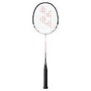
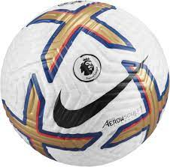
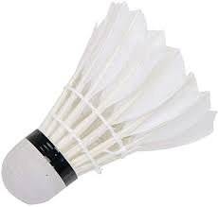
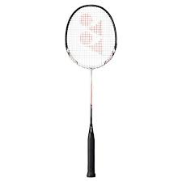
YEAR 7-11 Physical Education
Reviewing performance in planning and leading a sports
session
Provision for OAA in the UK
Plan, participate & evaluate in OAA
Hosting a major sporting event
R184: Contemporary issues in sport
The role of NGB’s
Destination Two – Continue studying PE/Sport at
Level 3 as a Cambridge Technical in Sport and Play
Role of sport values
Lead a sports activity session
YEAR 11
R187: Increasing awareness of outdoor and adventurous activities
Issues that affect participation
Organising and planning a sports session
Equipment requirements for OAA
Technology in sport
Tactical awareness
Key components of performance
‘How can I use my knowledge of tactics to outwit my opponent/s?’
Accurate replication of skills
Applying practice methods
YEAR 10
Skill development
Effective Use of sporting terminology
R185: Performance and leadership in sports activities
Skill & fitness assessment
Performance evaluation
Performance improvement
Accurate replication of skills
Skill development
YEAR 9
Components of fitness
Accurate replication of skills
Use of sporting terminology
Striking & fielding skills
‘How do I use my knowledge of the skills in a competitive situation effectively?
What is an effective performance?
Analysis of performance
Components of fitness
YEAR 8
Outwitting an opponent
Extracurricular clubs & links
Skill & fitness assessment
Accurate replication of skills
‘What is the key knowledge needed for each sport?’
Components of fitness
Use of sporting terminology
YEAR 7
Skill development
Skill & fitness assessment
LEARNING JOURNEY

