Slide 1
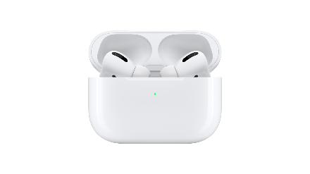
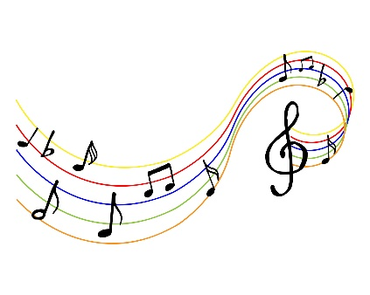
YEAR 7-11 MUSIC
Learning how to create two outcomes in either performance, composition or software
Learning how to plan and manage your musical development and record this
Work as a performer, composer or sequencer
Logging written developments
At NBA Post 16 we offer Level 3 BTEC in music performance and music tech for pupils who wish to develop their music skills in either pathway
Task 3: Tracking progress and contribution
Task 1: Planning a musical response to a brief
Component 2: Music Skills Development
YEAR 11
Task 2: Create a music product
Types of research
Reflecting and evaluating
Logging development practically
X3 commentary
Task 4: Evaluation & Portfolio submission
Producing two outcomes with the logs in a 15 hour practical
Learning to plan and develop musical ideas
Component 3: Responding to a brief
Coursework submission (based on given theme)
Practical: Playing or composing in a style to match the analysis
Key experience of BTEC coursework and learning
Rotation 3: Live Lounge
Producing three different practical performances
Links and research to examples of styles
Understand what an existing song is made of and how to produce it
Four different portfolio write ups
Creating different analysis of a genre of music
Assessment
Assessment
YEAR 10
Research different styles
Knowing about a range of styles of music from past to present
Assessment: Production of a portfolio with live music and written research
Working as a team and making a live song
Rehearsal & Performance of a ‘live lounge’ version of a song
Assessment
Live performance experience
BTEC Level 1/2 Tech award in music practice
Component 1: Exploring music products and styles
Rotation 2: ‘Genres of music’
Creating melody, texture, harmony & rhythms to a clip
DAW, recording & sequencing
Plaing riffs, chords & Syncopation
Assessment:
Merging of the two styles as a track
Topic 5:
Hip Hop Fusion
Assessment
Exporting & creating an MP3
Melodic layers and texture: Using DAW to create, loop, layer sequences
Assessment
Production of audio produced in a game clip
Assessment
YEAR 9
Assessment
Assessment
Assessment
Features of Games music Knowledge of different types of game, the styles of music to match and the features that enable the audio styles
Topic 6: Reggae
Topic 4: Minimalism
Assessment
Music & film Clip as a video file
Rotation 1: Games music
Assessment:
Performance of a reggae track
DAW: Using software to create music to a film clip
Assessment
Topic 5: Keyboard skills
Melody and Harmony:
Pieces with tunes and moving left hand harmony
Instruments, beats & Loops
Merging classical ideas with modern hip hop beats
Topic 3: Film Music
Pentatonics
Using Pentatonic notation to create a gamelan melody
Assessment:
Ensemble composition
Notation & structure: Playing Blues melodies and 12 bar chords
Assessment: playing group fusion patterns
Assessment:
Solo performance
Topic 2: Blues
Assessment
Assessment:
Solo performance of 12 bar blues
Rhythms &
Melodies
Different styles of rhythmic and melodic fusion patterns
Assessment
Assessment
YEAR 8
Assessment
Assessment
Notation:
Learning to read scores and notation to play the keyboard music
Rhythms & Melody:
Creating Djembe rhythms and upbeat African melodic patterns
Assessment:
Group composition performed to the class
Rotation 6: Gamelan
Rhythms and Layers:
What this is and how to utilize it in composition
Topic 1: African Rhythm & Melody
Topic 4: Bhangra Fusion
Singing: Learn to sing melodies as an ensemble
Assessment Ensemble singing a song
Assessment:
Performing Jingles
Melodies: Learn to create short melodies
Assessment: playing a song on their instrument
Assessment
Tablature: How to read tablature and chords
Assessment
Assessment
YEAR 7
Chords
Topic 3: Uke-pop
Elements: How to use pitch, tone, dynamics and expression
Topic 2: Musical Theatre (SATB)
Harmony: Learning what harmony is by using chords
Topic 1: Composing Jingles
Learning to play chords on the Ukulele and the Piano
LEARNING JOURNEY

