Slide 1
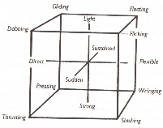
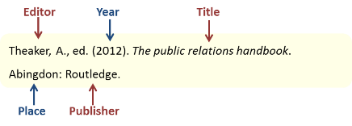
Motor Vehicle KS4
Assessment tasks
Lighting cluster – blown fuse, blown bulb, open circuit, short circuit, high resistance
Identify suitable workshop tools and equipment for working on automotive electrical systems.
Identify Vehicle Lighting Systems
Carry out tests on the electrical components
Solder parallel and series circuits
Identify tools and equipment
The Level 1 Award in Automotive Studies will give learners a broad understanding of the automotive sector whilst developing the numeracy, literacy and science knowledge applicable to the industry. This can be further enhanced by progressing onto the Level 2 Technical Certificates in Motor Vehicle Studies which will develop their knowledge further.
how to dispose of hazardous
waste
Replacing electrical components
Vehicle technician
Apprentice technician
Parts technician
Body technician
What can you do now?
Non hazards waste
Correct faults in the following electrical components
parallel circuits
RADS
Assessment Outcomes
The manufacture of the hand tool / accessory selected must include all the engineering processes outlined in the Qualification Guide
Identify Engineering Materials
Identify the mechanical fasteners which are used on motor vehicles.
series circuit
Electric circuits faults
different types of automotive battery.
Produce an engineering drawing
UNIT 4
Unit 4 automotive electrical principles
Disposing waste.
Manufacture an automotive accessory or hand tool suitable for use in the automotive
industry from a given specification.
Assessment tasks
To be completed on removal and refitting engine parts, steering parts, suspension parts and braking system parts
Identifying locking devices
How to handle engineering materials
Contextual factors and practitioners’ work
Identify different engineering tools.
UNIT 2
Remove and refit braking system components
Identify different types of engineering materials
Unit 2 Using engineering materials and skills
Remove and refit steering and suspension components
Report on condition of mechanical components
Understand about hazards and potential risks relevant to the automotive
Identify different types of waste produced by the automotive industry
Identify suitable workshop tools and equipment required for removal and re-fit of mechanical components.
UNIT 3
Assessments tasks unit 1
Remove and refit mechanical components
Impact of vehicle end of life cycle
Explain the importance of wearing the types of PPE required for a range of automotive repair activities
Unit 3 Remove and refit mechanical components
Remove Engine system components
Health and safety legislation
Be aware of
environmental impacts
Identify safety equipment suitable for use in automotive industry
Fire prevention
Identify safety signs and equipment.
Use tools correctly and safely.
UNIT 1
START
Employment and Progression opportunities
Be aware of HASAWA 1974 and all regulations.
Unit 1
Working in an Automotive Industry Environment
LEARNING JOURNEY

