Slide 1
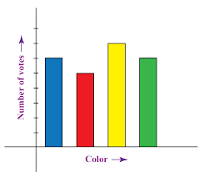
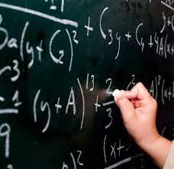
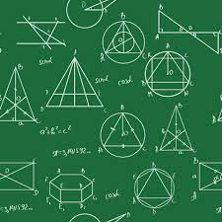
YEAR 7-11 MATHS
PIN BANK
Simply drag a pin to add it to your journey
Destination One: Qualifications for College Apprenticeships or Work.
Number Skills
Algebraic Skills
Number Skills
Destination Two – Continue studying mathematical at
A-Level.
YEAR 11
Algebra Skills
Data Handling
Geometric Skills
Geometric Skills
Algebra Skills
Algebra Skills
(Sequences and Graphs)
Data Handling (Averages)
Data Handling
Number Skills
(Ratio)
YEAR 10
Algebra Skills
Geometric Skills
Geometric Skills (Transformations)
Number Skills
Data Handling (Probability)
Data Handling
(Averages)
Geometric Skills
(Area & Volume)
Geometric Skills
Algebra Skills (Graphs)
YEAR 9
Number Skills
Number Skills
Data Handling
(Charts)
Data Handling
(Probability)
Algebra Skills
(Expressions and Equations)
Number Skills
(Ratio & Percentages)
Data Handling Skills
Algebraic Skills (Indices)
YEAR 8
Algebra Skills
Geometric Skills (Transformations)
Number Skills
Geometric Skills (Angles)
Number Skills
Number Skills
Number Skills
(Fractions)
YEAR 7
Geometric Skills (Area)
Geometric Skills (Perimeter)
LEARNING JOURNEY

