Slide 1
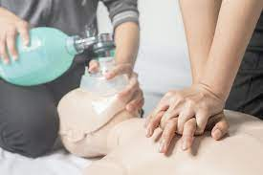
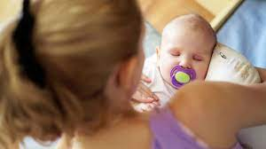
YEAR 10-11 Health and Social Care
Simply drag a pin to add it to your journey
Destination One: Qualifications for College Apprenticeships or Work.
Action plan
Destination Two Qualification to continue on at college or study and apprenticeship
Obstacles/barrier to action plan
Person centered approach
Reviewing own application
Access to services
Health Indicators
Interpreting health indicators
Health and Wellbeing
Impact of life events
Care Values
Services
Types of care
Care values in practice
Barriers
Physical factors
Social and cultural factors
Life events
Social Development
Economic factors
Types of support
Language Development
Physical Development
Main Life stages
Emotional Development
YEAR 10
Intellectual Development
Areas of growth and development
LEARNING JOURNEY

