Slide 1
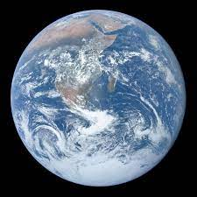
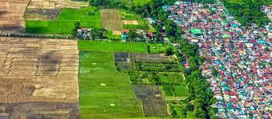
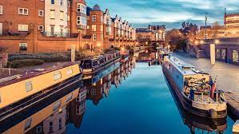
YEAR 7-11 Geography
PIN BANK
Simply drag a pin to add it to your journey
Destination One: Qualifications for College Apprenticeships or Work.
Fieldwork knowledge
Geographical skills
People of the planet
Destination Two – Continue studying Geography at
A-Level.
YEAR 11
Environmental threats
The economic world
Why is there still disease in the world?
Is our planet damaged beyond repair?
Urban issues
Is money more important or our planet?
YEAR 10
The Living World
How do I save my local area?
Natural Hazards
Is it too late to save our oceans?
Is the Middle East only important because of its oil?
Is Russia a controversial power?
Is India a superpower?
YEAR 9
We are going WHERE on holiday?
Is China a superpower?)
Is all Africa Poor?
YEAR 8
Should all young people move to the countryside?
Is Asia the most important continent?
How do coasts change?
Number Skills
Number Skills
Is Birmingham the centre of the UK?
YEAR 7
Are maps still important?
Is your walk to school the same as mine?
LEARNING JOURNEY

