Slide 1
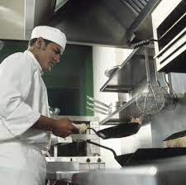
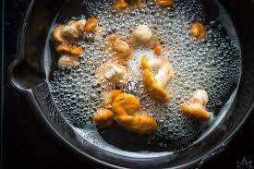
YEAR 11 Hospitality and Catering
PIN BANK
Simply drag a pin to add it to your journey
Apprenticeship in
Hosp & Catering
KS5 course at Higher Education
Operations of front and back of house
Working conditions in H&C Establishments
Unit 1 Written Exam Exam
Customer rneeds for different scenarios
H&C Establishments
Role of the EHO
Hospitality and Catering providers – commercial and non commercial
Health and safety training research
Reporting Injuries RIDDOR 2013
Risk Assessment and Accident forms
Personal safety
Unit 1 Written Exam Revision
COSHH 2002
Health and safety at work 1974
Personal Equipment 1992
Reducing/ setting
Assessment
PP
Assessment
Practical Assessment
Poaching/ sautéing
Sugar craft
Tempering of chocolate
Sous vide/ steaming
High Skill Techniques - Fileting
Pastry Products – Choux, puff, short crust
Higher skill – emulsions and sauces
Caramalising/ deglazing
START Unit 2 Practical
Skill Building
PP
Practical Assessment
Practical Exam Unit
Assessment
High Skill Techniques - Boning
High Skill Techniques – Sugar work
Grilling/ Baking
Production
Plan
Meeting Customer Needs
Three lessons per week
One - Unit 1 exam prep.
One - Unit 2 Controlled Assessment Prep
One – Unit 2 Practical skills lesson.
Over/ under nutrition
Unsatisfactory nutrition
Functions of Nutrients
Balancing a menu
START Controlled Assessment
Organoleptic- how dishes appeal to customers – sight, smell. Taste, touch
Environmental issues – Reduce, reuse, recycle
Factors to consider when proposing dishes for a menu
Cooking methods impacting on nutritional value
Compare nutritional needs of specific groups
LEARNING JOURNEY

