Slide 1
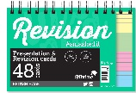
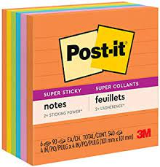
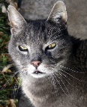
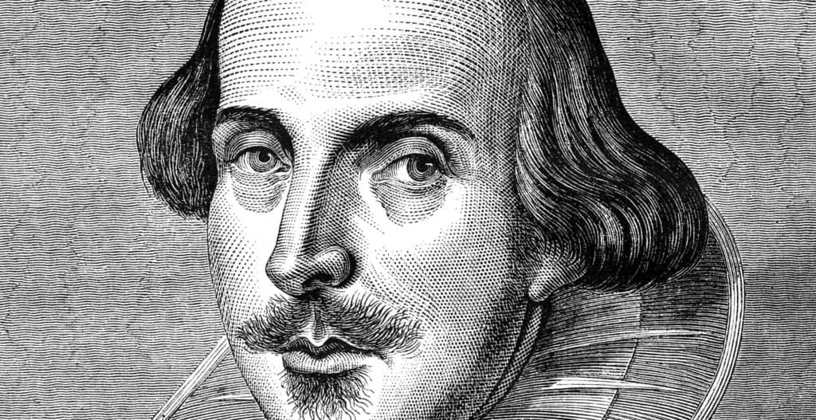
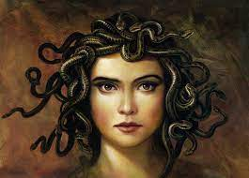
YEAR 7-11 ENGLISH
Destination One: Qualifications for College Apprenticeships or Work.
Revision of literature and language topics in preparation for exam.
Literature paper 2 revision
Literature paper 1 revision
Literature paper 2: Approaching Unseen poetry
Destination Two – Continue studying English Literature at
A-Level.
Language paper 2: Writers viewpoints and perspectives
YEAR 11
Language paper 2 revision
Literature paper 2: Conflict poetry anthology
Non fiction: Persuasive writing
Poetry: Culture and identity anthology
Language paper 1 revision
Literature paper 2: An Inspector Calls
YEAR 10
Language paper 1: Explorations in creative reading
Exploration in creative writing: Dystopian fiction
Macbeth: The fall of a tragic hero
Literature paper 1: Jekyll and Hyde
Non fiction: 19th/20th Century True Crime
YEAR 9
DNA: Studying a modern play
Creative writing: Crafting a setting
Animal Farm:
Explorations in creative writing
Sherlock Holmes: ‘A Scandal in Bohemia’.
Oliver Twist: Study of a Victorian novel
19th Century non fiction: Studying viewpoints and perspectives
Shakespeare’s:
The Tempest
YEAR 8
Poetry anthology: Metaphorical writing
Introduction to Shakespeare: Speeches and sonnets
Ancient Tales: Myths and Legends
YEAR 7
Ancient Tales: Crafting a hero
LEARNING JOURNEY

