Slide 1
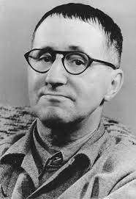
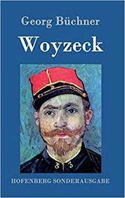
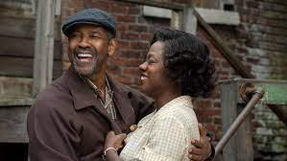
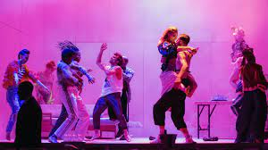
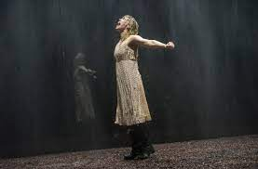
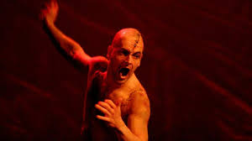
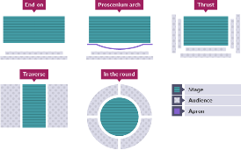
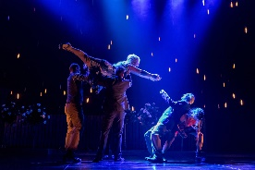
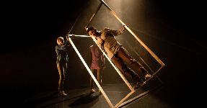
Drama & Theatre A-LEVEL
Drama teaches our young people empathy, communication and resilience. The A-Level course is ideal for individuals who are looking for pursue a career in acting. It supports those wishing to further their education and study theatre at university. The course focuses on acting/performance styles, practitioner methodologies, devising and allows for critical judgement, analysis and evaluation of live theatre.
External Assessment and Moderation
Written Exam (2 hours 30 Minutes)
Section A: Live Theatre (20 Marks)
Section B: Page To Stage (36 Marks)
Section C: Interpreting Text (24 Marks)
80 Marks (40% of Overall Qualification)
Brecht’s Epic Theatre
Placards, Mime, Multi-Role ,Narration, Verfremdungseffekt
Interpreting One Complete Performance Text, in Light of One Practitioner for a Contemporary Audience
Visual and Non-Verbal Forms of Communication
Set Text: Georg Büchner’s Woyzeck
Ways the Playwright has Communicated Ideas
Alumni destinations:
Performing Arts, Musical Theatre
Actor, Business Management
Accountancy, Recruitment
Midwifery, MH Nursing
What can you do now?
Physicality and Voice
Original Performance Conditions
Staging and Visual Impact
Practitioner Methodology
Performance Concept
External Assessment and Moderation
Mono/Duo (24 Marks)
Group Performance (36 Marks)
20% of Overall Qualification
Design Considerations: Costume, Set, Props, Lighting and Sound
Set Text: August Wilson’s ‘Fences’
Context
Contact, Relationships, Communication with other Performers on Stage (Proxemics)
Live Theatre Evaluation
Director’s Concept/Interpretation and Performance Style
Forming Critical Judgements
COMP 3
Mood/ Atmosphere
Page to Stage: Realisation of a Complete Performance Text
Vocal Expression Clarity, Pace, Inflection, Pitch and Projection
Physicality
Space, Gesture, Stillness and Stance
Theatre Makers In Practice
How Ideas were Communicated
Impact on Audience
Interpreting, Analysing and Evaluating
Communication and Engagement with the Audience.
Use of Performance Space and Spatial Relationships on Stage
Character Construction and Interpretation
Develop Textual Understanding and Interpretations of the Text
Understand Contemporary Practice and Theatre Makers
Rehearsing and Learning Lines
Social, Historical and Cultural Contexts
Relationships Between Performers and Audience
Style, Structure, Language and Stage Directions
Read and Research Chosen Extracts
Performance Space
Proscenium, Thrust, Traverse, In The Round
Two Key Extracts from Two Different Performance Texts
Spatial Relationships
Internal Assessment and Moderation
3000 Word Written Portfolio (60 Marks)
15-30 Minute Group Performance (20 Marks)
40% of Overall Qualification
Social, Historical, Cultural Contexts
Design Elements
Lighting, Sound Effects, Costume, Set Design, Props
COMP 2
Content, Genre and Form
Physical Skills
Language and Stage Directions
Characters and Characterisation
Text In Performance
Monologue/ Duologue and Group
Analysing and Evaluating
Inspired by One Key Extract of a Play
Practitioner Influence
Vocal Skills
Playwright’s Intention
Devising an Original Group Performance
Interpreting, Creating and Developing
COMP 1
START
Themes, Content, Genre, Style, Dialogue, Structure, Narrative and Form
Chair Duets, Round By Through, Hymns Hands, Fluff
Practical Exploration and Workshops of Frantic Assembly Methodologies and Techniques for Devising
LEARNING JOURNEY

