Slide 1
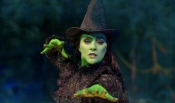
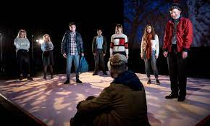
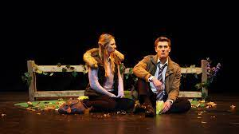
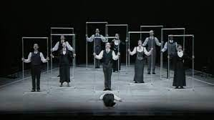
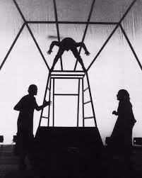
GCSE Drama KS4
Drama teaches our young people empathy, communication and resilience. The GCSE course is ideal for individuals who are looking to develop their skills in acting or build confidence. It supports those wishing to further their education and deepen their knowledge by studying Drama at College or Sixth Form. The course focuses on creating characters, design and technical theatre and allows for analysis and evaluation of professional work.
External Assessment and Moderation
Written Exam (1 hour 45 Minutes)
Section A: DNA (45 Marks)
Section B: Live Theatre Evaluation (15 Marks)
80 Marks (40% of Overall Qualification)
Form Critical Judgements about Live Theatre
How Ideas were Communicated During the Performance.
Performers in Specific Roles
Vocal and Physical Interpretation of Character
Design Considerations, Including the Use of Costume, Set, Lighting and Sound
Impact on the Audience
Live Theatre Evaluation
Analyse and Evaluate the Work of Theatre-Makers
At NBA Post 16 we offer the A-Level Drama and Theatre for those who wish to continue their performing journey!
What can you do now?
Original Performance Conditions
500 Words of Notes
Use of the Theatre Space
Director’s Concept/Interpretation and Chosen Performance Style
Genre, Structure, Character, Form, Style, Language and Stage Directions
External Assessment and Moderation
Mono/Duo (24 Marks)
Group Performance (24 Marks)
20% of Overall Qualification
Set and Props, Stage Furniture and Personal Props
Lighting and Sound, Colour and Music
Communicating with other Performers on Stage
‘DNA’ by Dennis Kelly
Stage Space and Spatial Relationships
Social, Historical and
Cultural Contexts
COMP 3
Artistic Intentions
Costume and Make-up
Performance Style and Theatrical Devices
Performing to an Audience
Theatre Makers In Practice
Acting Style and Purpose, Vocal and Physical skills
Impact and Meaning for the Audience.
Rehearsing and Learning Lines
Production Elements Set, Props, Costume, Lighting and Sound
Communication with other Performers and/or with the Audience.
Communicating Creative Intent to Audience
Presentation of Characters/Roles
Genre, Structure, Form, Style, Language and Stage Directions
Developing Interpretations Independently and Collaboratively
Character Development
Voice and Physicality
Characterisation
Relationships Between Performers and Audience
Use of Voice, Physical and Non-Verbal Techniques
Themes, Issues, Performance Conventions
Voice: use of Clarity, Pace, Inflection, Pitch and Projection
Developing Movement and Physical Sequences
Characterisation and Communication with Audience
Adapting Work in Response to Rehearsals
Internal Assessment and Moderation
2000 Word Written Portfolio (45 Marks)
10-25 Minute Group Performance (15 Marks)
40% of Overall Qualification
Two Key Extracts from the Same Performance Text
COMP 2
Character Relationships
Tableaux, Role on the Wall, Hot-Seating
Improvisation
Physicality: use of Space, Gesture, Stillness and Stance
Rehearsing and Learning Lines
Performance from Text
Monologue/ Duologue and Group
Developing Ideas and Intentions
Analysing and Evaluating the Creative Process
Group Performance
Devising an Original Group Performance
Research
Performance Conventions
Relationships between Performer and Audience.
COMP 1
START
Use of Space and Spatial Relationships on Stage
Genre, Structure, Character, Form, Style, and Language
Creating and developing a devised piece from textual, visual, aural or abstract stimuli.
LEARNING JOURNEY

