Slide 1
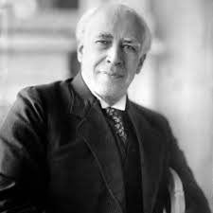
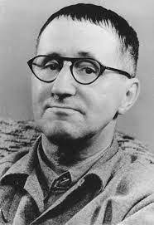
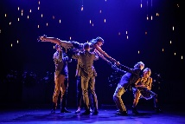
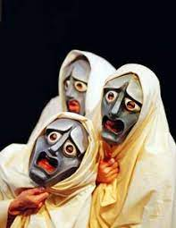
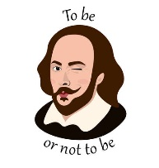
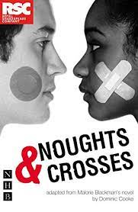
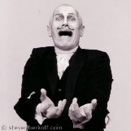
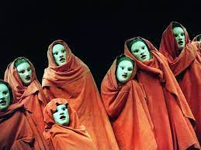
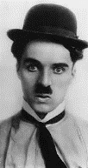
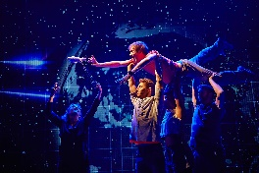
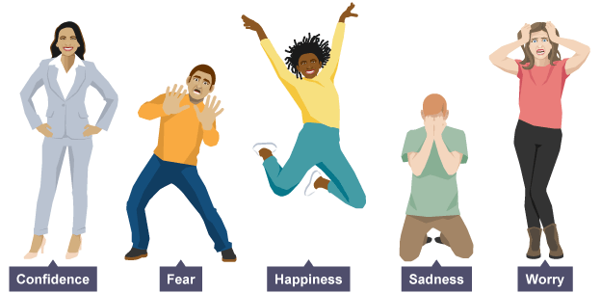
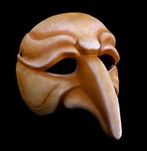
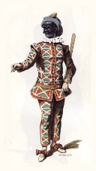
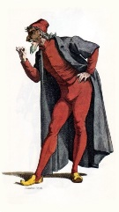
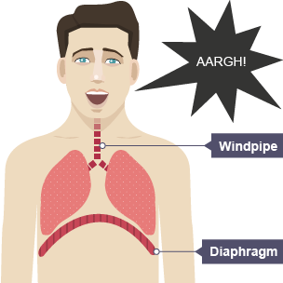
KEY STAGE 3 DRAMA
Creating original work in the style of any practitioner and influence from their methodologies
Drama enables students to build confidence, resilience and to develop focus. Drama promotes opportunities for students to work as part of a group to enhance communication and teamwork effectively. Drama provides students a safe and stimulating environment to encourage their creativity and expression.
Students will perform a devised piece focusing on their interpretation of the stimuli and application of skills and techniques
Technical Theatre
Lighting, Staging, Props, Costume and sound
Devising
from a Stimulus
Naturalism; Given Circumstances, Magic If, Emotion Memory, Units of Action, Objectives
Actor
Performance Artist
Stage Manger
Teacher
Epic Theatre; Placards, Multi-Role, Alienation, Mime, Narration
Lecturer
Costume Designer
Assessment
Playwright
Set Designer
Why continue onto KS4 Drama?
Assessment
Director
Using devising techniques; brainstorming, freeze-frames, hot-seating
Events Planner
Students will perform duologue or group piece in the style of one practitioner; ‘Two’ or ‘Bouncers’
Technician: Lighting & Sound
The impact of using Accent to show class divide
Students will perform the end scene focusing on Proxemics
Understanding the methodologies of Frantic Assembly
Storytelling through movement and risk taking, using a range of devising techniques; Chair Duets and Lifts
Practitioners
Stanislavski and Brecht
9
Explore 2 contrasting performance styles
Foreshadowing and Structure
Assessment
Assessment
The role of the Narrator and the use of Direct Address
Physical Theatre
Theatre Styles
Students will create a piece of physical theatre inspired by Frantic using a text as stimulus
Shakespeare for Schools
‘Othello’
Creating Meaning and Tension for the audience
Students will perform an ensemble piece from the play ‘Metamorphosis’ or ‘The Trial’
Total Theatre
Physical Theatre, Mime, Exaggeration, Stylised Movement and Improvisation
Elements of Greek Tragedy
Scripted
‘Blood Brothers’
Assessment
Choral Movement and Choral Speech
Assessment
Understanding Genre; elements of Shakespearean Tragedy and Themes
Focus on Naturalistic style of performance
Noughts and Crosses
Interpreting Text
Practitioner
Steven Berkoff
Working effectively as an ensemble in unison to communicate an idea
Students will create and group performance using the archetypal characters of the theatre of commedia .
Using text to create performance
Focus on spoken dialogue, use of voice and stage directions
Students will perform a scene from the play using a range of drama techniques; still image, role-play, soundscape and split-screen to structure their performance
Characterisation How to show status through the body and build a character
8
Greek Theatre
Chorus
Acting Style
Focus on elements of mime, non-verbal communication and slap-stick comedy
Assessment
Assessment
Rotation 3: Page to Stage
‘The Curious Incident’
The effect of using Mannerisms
Exploration of key plot points and narrative
Rotation 2: Commedia Dell’Arte
Physical Skills Facial Expression, Levels, Gestures, Space
Vocal Skills Volume, Pace and Tone
Focus on communicating the emotions of a character
Rotation 1: Basic Skills
‘Inside Out’
7
Assessment
START
Students will create a group performance demonstrating their understanding of 5 key emotions through the application of physical and vocal skills in role.
Performance Skills:
Voice (Volume, Tone, Pitch, Pace, Pause, Accent, Diction) and Physicality
(Facial Expression, Body Language, Gestures, Levels, Space, Mannerisms, Posture).
LEARNING JOURNEY

