Slide 1
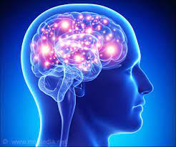
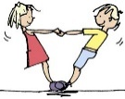
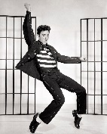
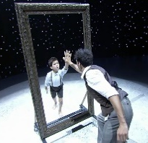
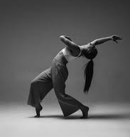
YEAR 7-11 DANCE
Learning a professional piece of repertoire (external brief, released in Dec)
Review choreographic methods and devices
Reflecting and improving performance
What is effective rehearsal?
At NBA Post 16 we offer the Level 3 BTEC in Performing Arts (Dance) for those who wish to continue their dance studies.
Task 3: Final Performance
Task 1: Response to the brief
Component 2: Developing skills and techniques for live performance
YEAR 11
Task 2: Development of skills
Component 3: Responding to a brief
Types of research
Performance Skills
Contemporary dance technique
Task 4: Evaluation
Final performance and submission of written journals
Purpose of performance
Using dynamics for musicality and timing
Gathering choreographic inspiration
Coursework submission (based on given theme)
Expressive Skill: Communication of choreographic intention
Rotation 3: Choreography
Production and development process
Styles of dance and musical theatre
Understand the 3 given stimuli and generate ideas
Job roles in the industry and responsibilities
Replicate and manipulate taught movement
Assessment
Assessment
YEAR 10
Creative stylistic qualities
Understand the given stimulus and generate ideas
Students will perform their group piece ‘Surround by Sand’
Working with musicians and actors
Technical Theatre – Lighting, Staging, Props, Costume
Students perform their final piece of work for KS3.
BTEC Level 2 in Performing Arts with a dance approach
Component 1: Exploring the performing arts
Rotation 2: ‘Surrounded by Sand’
Assessment
Learning and replicating dance sequences
Unison, Canon, Repetition
Students will be assessed throughout the term at various points (performance of a piece worked on over several weeks) in order to determine a final grade
Direct Correlation
Matching the movement and the music exactly
Students will apply choreographic devices to manipulate a taught routine into a new sequence
YEAR 9
Motif Development Addition, Subtraction, Dynamics, Fragmentation, Retrograde, Space
Rotation 1: Choreographic Devices
Musicality
Emulating the qualities of the music through movement
Stimulus using an event or popular figure (using a significant prop)
Students will choose one of 2 musical theatre pieces they have learnt for final performance including their own movement in the same style
Auditory Stimulus: Music
Dance Relationships
Rotation 3: Musical Theatre
Musical Theatre repertoire
(Students must replicate the movement)
Visual Stimulus: Picture
Stimulus using words (creating a story)
Rock & Roll Dance Sequence
(Students must replicate the movement)
Contact Work
Assessment
Assessment
YEAR 8
Stimulus:
Inspiration for a dance idea
Students will create a Rock and Roll dance that includes the taught sequence and contact work.
Choreography within the style of the musical
Matching movement to lyrics of the song
Choreographic Intention:
What you aim to communicate to the audience
Rotation 2: Rock and Roll Dance
Choreography – Stimuli & Intention
Dance Relationships Mirroring, Action & Reaction
Spatial Content Levels, Directions
Dynamic Content Fast & Slow
Choreographic Devices Unison & Canon
Students will create a group performance demonstrating their understanding of dance technical skills.
Assessment
YEAR 7
Dance Actions: Gesture, Elevation, Turn, Stillness, Travel, Use of different body parts, Floorwork, Transfer of Weight
These 8 actions provide the foundation for the whole dance curriculum and will be used in every lesson from Year 7 – 13.
Rotation 1: Dance Technical Skills
LEARNING JOURNEY

